Slide 1
Impact of Rising Sea and Land Temperatures on Cyclonic Storms.
Jawaid Hakim

Slide 2
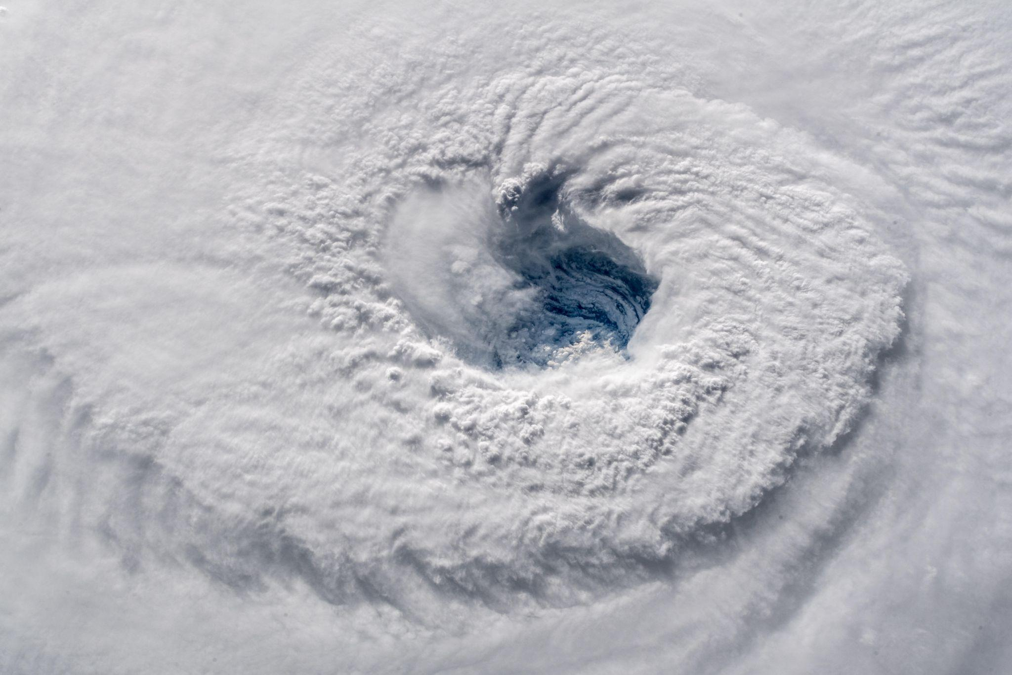
Cyclonic Storms
We are all familiar with the classic image of Cyclonic storms - swirling engines of raw power.
The scale of these immense weather systems is truly awe inspiring.
Image of Hurricane Florence eye taken from space (NASA).

Slide 3
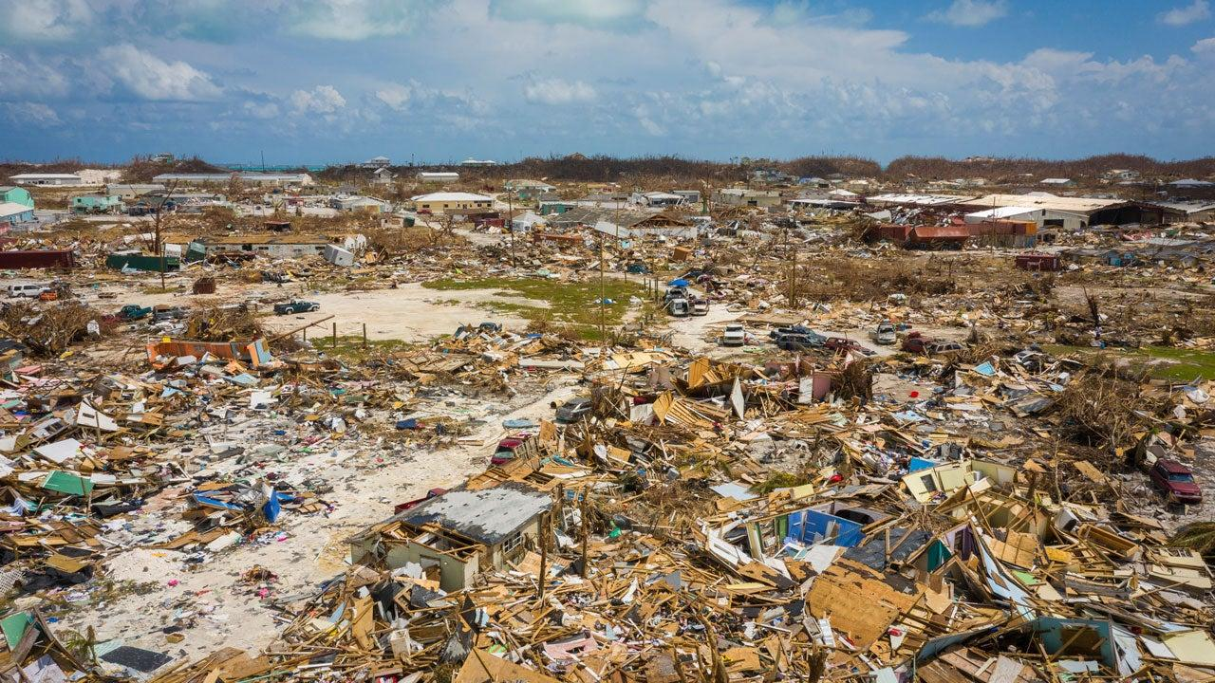
Raw Power
Cyclonic Storms have the potential for causing catastrophic loss of life and property.
Economic costs are measured in Billions of Dollars.
Devastation is seen in Marsh Harbour from Hurricane Dorian, Abaco Islands, Bahamas, on Sept. 11, 2019. Estimated loss of $3.4 Billion on Bahamas. Death toll was estimated at 74 with 245 missing.

Slide 4
Cyclonic Storms - Terminology
Once a tropical cyclone reaches maximum sustained winds of 74 miles per hour or higher, it is classified either as a hurricane, typhoon, or tropical cyclone:
North Atlantic : Hurricane
Central North Pacific: Typhoon
Eastern North Pacific: Tropical Cyclone

Slide 5
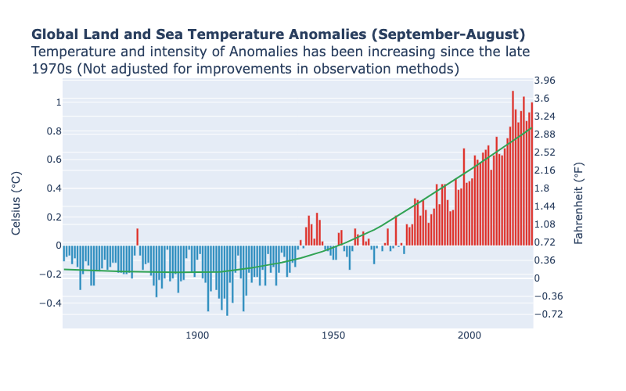
Land and Sea Temperature Anomalies
Cyclonic Storms form over Oceans and are fueled by water temperatures of the nurseries in which they are born.
Land and Sea temperature anomalies have been rising since 1970s.
What impact does rising Sea and Land temperature have on Cyclonic Storms?

Slide 6
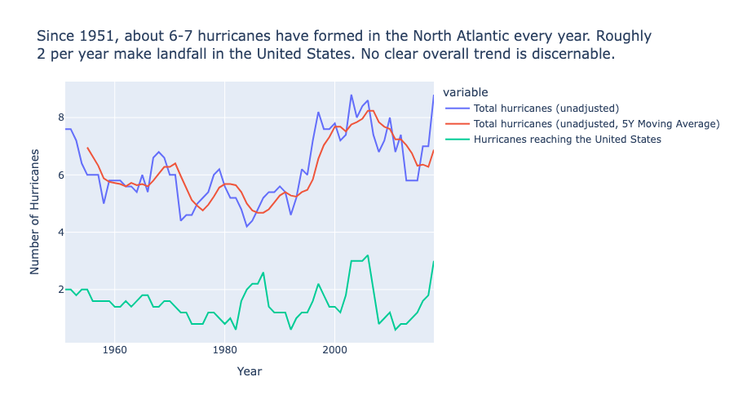
Frequency of Hurricanes in the North Atlantic
Frequency of Hurricanes forming in the North Atlantic every year has not changed significantly since 1951.
Over this period, the number of Hurricanes making landfall in the United States has stayed roughly at 2.

Slide 7
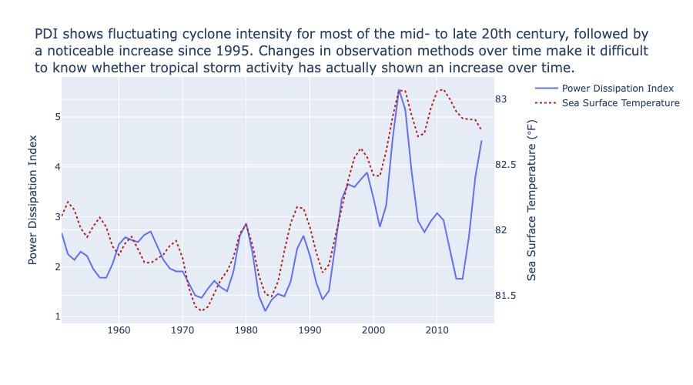
Power Dissipation Index (PDI)
The Power Dissipation Index (PDI) measures the activity of cyclones by accounting for cyclone strength, duration, and frequency.
There has been a noticeable increase in PDI since 1995.
However, changes in observation methods make is difficult to know whether this is a definite trend.

Slide 8
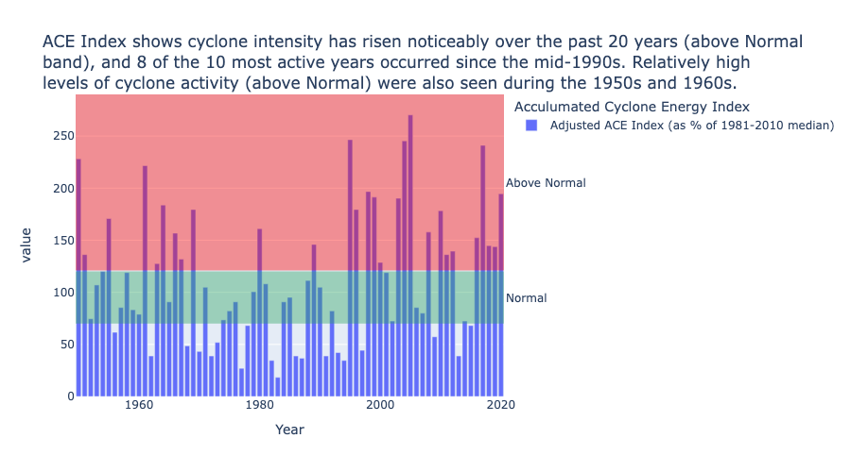
Accumulated Cyclone Energy (ACE) Index
The ACE index is essentially a wind energy index.
There has been a noticeable increase (above Normal) in the ACE Index in the last 20 years.

Slide 9
Conclusion
Frequency of Hurricanes forming in the North Atlantic and those making landfall in the United States each year has stayed roughly the same over the last 75 years.
The intensity of Cyclonic Storms, as measured by the Accumulated Cyclone Energy (ACE) Index, has increased over the past 20 years.
Changes in observation methods makes it difficult to know whether tropical storm activity has actually shown an increase over time.

Slide 10
Appendix - Data
Land and Sea Temperature Anomalies - https://www.ncei.noaa.gov/access/monitoring/climate-at-a-glance/global/time-series/globe/land_ocean/12/8/1850-2023?filter=true&filterType=loess
Frequency of Hurricanes in North Atlantic, PDI, ACE Index - https://www.epa.gov/climate-indicators/climate-change-indicators-tropical-cyclone-activity#tab-4

